Slide 1
Crafting Effective resumes for recent MSW graduates
Richard L Beaulaurier, PhD, MSW
Notes:
The title comes from Chat GPT… Of course this is almost identical to the what I asked it to do. Did not use the subtitle: Navigating the Job Market with Confidence.
Did not use the subtitle…because, although catchy, it’s not what this is about.
Did not add the date…that would show when it has become dated ;-)

Slide 2
Shout out to my co-authors:
PowerPoint Design Tools
Chat GPT
Spellcheck

Slide 3
Agenda
Understanding what a resume is and what it is not.
Understand how a resume fits into a job search.
Understand how Resumes are used by employers
Conventional screening
AI screening
Focus on resumes for aimed to get your first post-graduate job.

Slide 4
Curriculum Vitae→Lebenslauf→Resume
Historical
Current Professional
Resume
Academic CV
A resume showed the course of your life from the murky past to the present
Could show things considered irrelevant or illegal today
Gender
Age
Class
Bulk was best. Resumes were very long.
Succinct
Shows only
Relevant info about you
Shows only experience relevant to job market.
More like a big calling card than a biography
Designed to be used in screening.
Made to be as long as possible.
Show everything you can legitimately claim
Does not resemble other professional resumes
How many academics does it take to screw in a light bulb?

Slide 5
Resumes in the USA
Normal Expectations
What not to add
Resumes should be short. Most should be one page in length. Two maximum, but only in exceptional cases.
White paper/background
Easy to read font.
Most important information
Easy to find
Usually at the top
No handwriting
No picture
No High School Information
Limit jobs if they are not relevant
Dates are not usually necessary
No excessive creativity
No robots

Slide 6
The first commandment
Thou shalt put nothing in thy resume that will get thee screened out.

Slide 7
Second Commandment
Thou shalt have thy resume screened
HR Low person on the totem pole
Most Junior Administrative Assistant
Rando called in because they needed someone to screen resumes
The AI du jour
(notice the robotic smile)

Slide 8
The first stop for your Resume is a big pile of resumes
Traditionally (and still today) some low-ranking person would screen resumes from to select 10
Screening may not also be done partially or fully by AI
A much smaller number will usually be screened by a higher-ranking person…but not the decision maker
No decision maker is going to read more than 10 resumes.

Slide 9
Getting through the screening
Make your REAL qualifications clear:
Education
Certifications
Relevant experience
Follow this with things may put you over the top
Special qualification
Memberships
Leadership positions
References
Use key words and language common in SW jobs
Generic
Sector specific
Notes:
The case for independent living.

Slide 10
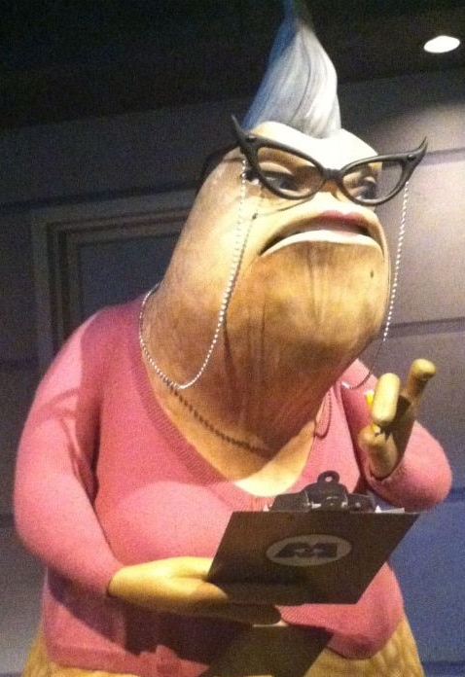
How to get screened out
Make your qualifications hard to find
Make the resume too busy
Include TMI
Misspell or use bad grammar
Use colloquialisms
Include irrelevant or extraneous info such as
Desired Position
Goals or Objectives
Info about jobs/experience not relevant to SW positions
Info about education prior to your BA
Information about your age

Slide 11
“I thought I was supposed to have a goal, objective”
Many resume workshops suggest this. So many that my AI assistant recommended it as well.
Statements of goals, objectives may be used to screen you out.
If your statement is inconsistent with the job description you will be screened out
If your objective is too high they believe you will not be satisfied with the job they are offering.
If your objective is too low they may think you lack drive or ambition.
If the objective is too specific they may not consider you for other jobs

Slide 12
“But shouldn’t I tell them what position I am going for?”
Same problem as with goals and objectives. This can be used to screen you out.
It is at best unnecessary. You have applied for a position. They can assume you want it.
Even if the position you have applied for is exactly your desired position, they may not see you in it…and your statement may prevent consideration for other positions they have open.
You run the risk of looking overly ambitious, or under ambitious.

Slide 13
Rich’s Suggested order
Name with degree first: Louise Labissoniere, MSW
Contact info
Address
Email
Phone
Education ←This is your most important qualification
MSW, Florida International University
BSSW (or BA or BS) University Name
AA, AS (if you have it)
Certifications or Licenses
Social work Experience
Other Relevant Experience
If not that relevant summarize briefly
Offices, Honors, Awards
References on demand (or you can name them if known to employer)
Notes:
Your degree is your most important qualification upon graduation.

Slide 14
Qualifications
If the job you are after requires and MSW then your principal qualification is the MSW.
If certifications are required, make sure they are prominent.
The least important qualification is your work experience at this stage.
Describe your SW activities. What do you know how to do? What do you have as skills?
Honors and awards won’t get you the job but may put you over the top.
Reference names should not be specified…unless they will help.
Knowing how to use a computer is not a qualification.
Notes:
In your next job work experience will be important, but that is less true with this one.

Slide 15
Skills and Actions over Positions Held
Taught independent living skills to aging-out foster care youth
Conducted group and individual therapy sessions in English and Spanish.
Translated materials from English to Kreyol
Presented project findings to a statewide conference
Developed an evidence based program for recent immigrant youth
Implemented an independent living curriculum to seniors in adult day care
Positions held
Interned at Citrus Health Network
Interned at some other place
Guardian ad Litem
Middle school teacher
Parole officer
Notes:
Experience.

Slide 16
Honors, awards, certifications, in school and prior to school…
Do not substitute for qualifications
CAN put you over the top if you have them
Show leadership and ambition better than a position statement.

Slide 17
Calling Card
You are more likely to get a job with your resume as a calling card than applying electronically.
Develop your resume NOW
Always have it handy to give to people who might have a job for you…or might know someone who does.
This can short-circuit the screening process and land you on the decision maker’s desk.
Develop contacts and be prepared to hand them a resume.

Slide 18
But what about AI?
AI is being used more frequently by employers as part of the screening process
AI is also being used by job-seekers
The title of this presentation was generated by AI
AI suggested content for this presentation
AI provided some helpful information…
…but not that much…

Slide 19
Robot Overlords? Not quite…
I did some AI queries, which I will make available to you.
It is of some use
It spells well and has good grammar.
It can help with highly general stuff.
It is far too general to be of much use in our field.
AI lacks specifics that are likely to make the difference in the hiring process.

Slide 20
Screening with AI
Increasingly employer are using Applicant Tracking Systems (ATS)
ATS can filter resumes based on keywords, and qualifications, formatting analysis, and natural language processing (NLP)
HR may believe ATS is less biased. (may not be true)
HR may believe that ATS is more efficient (i.e. cheaper)
AI makes it possible to process enormous quantities of resumes and come down to a few.
Converts unstructured data to structured data.
Makes side by side comparison easier for human reviewers.
Can do contextual analysis for relevance of key words.
Filter based on pre-defined criteria.

Slide 21
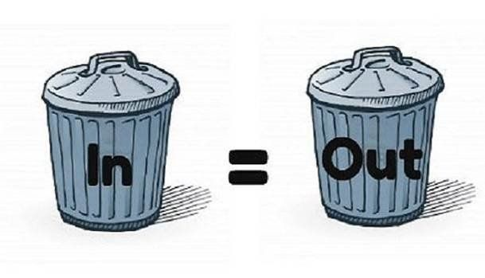
What could go wrong screening with AI? GIGO part 1
Pre-defined criteria may be biased.
Only eliminates known human bias, but does may include systematic or implicit bias
HR may believe ATS is less biased. (may not be true)
HR may believe that ATS is more efficient (i.e. cheaper)
AI will rank if told to, whether it makes sense to or not
Will filter based on criteria that it’s given
Biases toward structure
Can be superficial

Slide 22
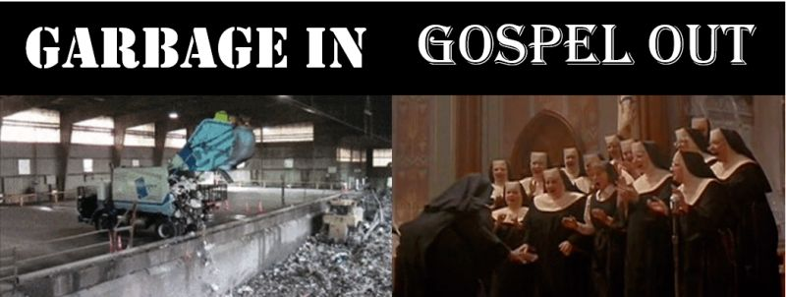
There will be more ATS GIGO part 2
AI can be superficial
Can bias toward overgeneralization
Particularly when employers don’t know exactly what they want
If criteria given to the AI are biased, the filtering will be biased.
BUT
It is cheaper (at least in the short run) to buy an ATS than it is to hire screeners
Employers are getting more and more resumes for positions they open. Need a quick screening tool.
Although ATS may be filled with systematic and implicit bias, it is being marketed as “objective” and not subject to “human bias”

Slide 23
What can you do about AI Screening?
Chat GPT says…
Understand AI tools
Key words, content, formatting.
Find a good AI tool
Chat GPT identified “popular ones”
Use it to tailor your resume, use Natural Language Processing (NLP)
Optimize LinkedIn
Rich Says…
Do your own keyword optimization by looking at job descriptions.
Use the AI for suggestions about how to phrase things.
Be MORE specific than the AI about your activities and experiences.
Give the resume to a human to read

Slide 24
What else can you do?
Prepare for post screening:
First things first:
Name and degree
Education
Certifications
Experience
Human screeners may not read the whole resume
The first half page is most important
The 2nd half page is next most important
The 3rd page should not be there.
Actions speak louder than adjectives.
Start with an action verb
Use numbers when they are impressive.
Proof carefully, and put things in simple, neat order.
Give the resume to a human to read.

Slide 25
About employers…
The most important decision a manager can make is about who to hire.
Great hires will make them look great.
Poor hires will do the manager who hires them irreparable harm.
Yet, they often know very little about how to hire such a person.
Employers rely on informal networks and recommendations to find the best people.
It’s always best for them to hear from someone they trust, that there is more to this person than the resume.
SO…it may be more important what people say about you than what you say in your resume.

Slide 26
There’s got to be a better way!
You will most likely need to be overqualified to successfully make it through screening.
Sending in your resume to a screener is necessary but not a great way to get your dream job
If you can get to the decision maker without going through screening that is much better!
Tell everyone you know what your dream job is, and give them a copy of your resume.
Develop your contacts.
Contacts can be anyone who knows anyone.
Not having contacts is no excuse for not having contacts. ➔ Develop contacts!

Slide 27
Thank you !
Now let’s see if we can punch up some resumes!

