Slide 1
Annual PhD Student Meeting or Getting Oriented to the Doctoral Program in SW Phases I, II and III

Slide 2
AGENDA (in no particular order)
Being a Graduate Student at FIU
Graduate Student Handbook
Plagiarism
Turnitin
IThenticate
Responsible Conduct of Research
Milestones (Formerly “D-Forms”)
Orientation to Phase I (aka coursework phase)
Course requirements Fall, spring and summer
Social work difference peculiarities
Annual and semi-annual evaluations
Orientation to Phase II (aka qual phase)
Candidacy in SW: Qualifying “Exams”
SW peculiarities revisited
Chairs and committees
Qual papers
Orientation to the Phase III (aka Dissertation phase )
Chairs and committees redux
Traditional vs “Three paper”
The last semester

Slide 3
Schools and Child Care
FIU Children’s Creative Learning Center
Public Schools
“Home” school
Carlos J Finlay Elementary
Magnet School
Charter Schools
Private Schools
Center for Children and Families

Slide 4
How do I find a place to live?
Housing and Residential Life
https://studentaffairs.fiu.edu/campus-services/housing-and-residential-life/
University City
Off campus Housing
https://www.fiuoffcampushousing.com/
Ask other Doctoral Students

Slide 5
Outside Employment
It is extremely difficult to work in the first year
Best if it is 20 hours with a professor
Keep outside activity to a minimum
FIU will allow additional awards
After the first year, PT employment if not on GA contract
But the university will sometimes allow additional awards up to a fixed amount
UGS will also sometimes match awards.
These awards must be approved by UGS.
However, outside activity will generally slow you down.
The more structured, responsible or time-consuming, the more it will slow you down.

Slide 6
LCSW
The SSW does not support getting hours or taking the exam for the LCSW
If you are very close, there are occasionally opportunities to finish hours.
If you have not started the LCSW, graduate first.
The hours and study for the exam will slow your progress.
Can jeopardize other funding you may have.
If you have an LCSW there are occasionally opportunities on research projects for clinicians.
There are also opportunities to get the LCSW after graduating
CSWE does have a practice requirement for some courses, BUT does not require an LCSW to teach

Slide 7
Who will hire me when I graduate?
Why has employment been improving for PhD’s in SW?
Need for people to identify, develop and evaluate evidence-based practices
Retirement of faculty in schools of Social Work
Employment in other academic fields
Employment with institutes and think tanks
Expanding market for leadership in industry
New markets opening outside the USA
Institutions that do training (CEU and Organizational)
Does employment require an MSW/practice experience?
Some positions do
Most do not

Slide 8
FIU Campuses & Facilities
Software & Hardware
Panthertech
eLabs
Student Life
https://www.fiu.edu/student-life/index.html
GPSC
http://gradschool.fiu.edu/gpsc/
(may have travel funds)
Clubs and Organizations
https://www.fiu.edu/student-life/student-involvement/index.html
Arts & Culture
https://www.fiu.edu/student-life/arts-and-culture/index.html
Rec Centers & Outdoor Activities
https://www.fiu.edu/student-life/index.html
Campuses
https://www.fiu.edu/student-life/campus-highlights/index.html

Slide 9
Dr. B’s Internet Kitchen Drawer**
The world wide web was invented in Switzerland in 1989 so that absent minded professors could find and share resources.
In this tradition, Dr B created the kitchen drawer page to find (and share) things he frequently forgets.
Working on developing a better way to share resources…but until then:
What can you find there?
This powerpoint*
The “old VPN trick” for using the library, eLabs and other FIU computer resources.*
Google search tips
Other stuff you may never use
http://beau.fiu.edu/references.htm
http://beau.fiu.edu ➔ Select “miscellany” from the menu on the left. **
*These are likely to be very important to you at some point.
** You will need to type http:// in front of The URL. Otherwise you may get a 404 message.

Slide 10
The Handbook
Located here: https://stempel.fiu.edu/_assets/docs/fiu_social_welfare_phd_handbook_2019_1201.pdf
If you do a web search, make sure it is the one from 2019.
FIU is prone to having zombie pages
Any other “handbook” that you find is out of date.

Slide 11
Plagiarism
There has been a rash of plagiarism in academia, and a handful known cases in FIU dissertations
Some resources for recognizing and avoiding plagiarism:
https://case.fiu.edu/opportunities/internships-jobs/clinical-experiences/plagiarism-tutorial/
https://library.fiu.edu/plagiarism
How it often happens, and advice for avoiding inadvertent plagiarism
Resources FIU uses
Turnitin (Required in Stempel
I-Thenticate (in beta test)
How the we use Turnitin in class and the college.

Slide 12
Responsible Conduct of Research (RCR)
Institutional Review Board (IRB)
https://research.fiu.edu/irb/
RCR Required training
SELECT: CITI Social and Behavioral Responsible Conduct of Research Course.
https://research.fiu.edu/rcr/training/
https://gradschool.fiu.edu/rcr/
The system will generate a receipt that you will need to keep.
Research Misconduct
https://research.fiu.edu/research-misconduct/

Slide 13
Other Questions?

Slide 14
SW Faculty with Graduate Faculty Status
Affiliated/Courtesy/NTE
Last Name | First Name
Boren | Shedrick
Morris | Staci
Wilson | Courtney
Tenure/Tenure Earning
Last Name | First Name
Beaulaurier | Richard
Burke | Shanna L.
Castillo | Berenice
De La Rosa | Mario
Fava | Nicole M.
Fernandez | Sofia B.
Gil | Andres G.
Macgowan | Mark J.
Potocky | Miriam
Wagner | Eric F.
A list of all graduate faculty at FIU can be found here:
https://gradschool.fiu.edu/facultystaff/#toggle-id-18-closed
Bottom of the page, click on the college to get the list

Slide 15
Getting to the Dissertation in SW at FIU
Nuts and Bolts

Slide 16
Stages of Doctoral Study
Doctoral Student Phase
Coursework 3 semesters @ 12 credits each, Fall, Spring, Summer of the 1st year
Qualifying Exam Phase
Two major papers, Policy/Problem and Intervention
Doctoral Candidacy
Dissertation Proposal
Dissertation
Traditional
Three-paper
Apply for DEA?
Apply for DYF?

Slide 17
Magnificent Milestones (formerly the Deadly D’s)
Application for Candidacy
Appointment of Dissertation Committee
D-1r Change in Dissertation Committee (This one is still a D-form)
Non-FIU Commitment form
Dissertation Proposal
Cannot be accepted without CITI training
Cannot be accepted without IRB Certification
Preliminary Approval and Request for Oral Defense
Final Electronic Dissertation Approval
But wait! There’s more!
Annual Eval (UGS)
Semi-annual Eval (Stempel)
NEW: Qual Committee and Progress form (Social Work)
Publication /Presentation requests

Slide 18
Candidacy Comes First
Quals committees have no more than three members
Chair from SW
Member from SW
Member from FIU (SW or “outside”)
On completion of the Qual file Application for Candidacy
On submission of D-2 begin enrolling in dissertation credits
Papers submitted as a qual may not be submitted for publication before approval by the committee
There are two committees in SW
Qualifying exam
Dissertation
In SW you achieve candidacy by passing your quals
Quals consist of two major papers
Problem/policy
Intervention

Slide 19
Dissertation Committee
Dissertation Committees have 4 members from FIU
Chair from SW
Two members from SW
One member from elsewhere at FIU
You may add additional members
…but it complicates matters…
Additional members from FIU are simple to add
Additional members from outside FIU require additional documentation
Non-FIU Commitment Form
Members from outside do not replace the outside member FIU
Members from outside FIU may be
In Schools of Social Work
Social workers, but not in a SSW
May not replace the outside member from FIU
Milestone Submitted at UGS
Once milestone submitted all committee members must sign the annual eval
Best not to do this before filing for Candidacy
Non-quals members don’t know your work

Slide 20
Committees continued
Use the Non-FIU Commitment Form to add members from outside.
Non-FIU members require a bio, a CV and approval to be appointed.
Use the D-1r form to change a dissertation committee
The committee that signs off on your annual review will not be changed until this form is approved.
If you need to change the committee, the “D-1r” form is still used to apply for a revision.

Slide 21
Proposal Defense
This consists of two documents and an oral defense.
A lengthy proposal that
Provides background and justification for research questions
Provides detailed methods
A brief 5-page proposal summary of the former document that will go to UGS
Both documents should have received agreement from the dissertation committee to move forward
Dissertation Committee Milestone should be approved by UGS before proposal defense
Once defense has been conducted submit the Proposal Milestone
There are no deadlines for when D3 can be conducted BUT this is where we begin watching deadlines
D-3 “is to be completed” three semesters before graduation
Continuous enrollment begins now.
IRB approval goes in with Proposal Milestone

Slide 22
Dissertation Defense & Submission
Watch the Dates
Oral Defense and Final Electronic Approval Milestones separate due dates for
The Dean’s office
UGS
Generally you must be ready to do the Oral Defense Milestone at the beginning of the semester in which you plan to graduate
Oral Defense Milestone must be approved to approve a defense date.
The earlier in the semester Oral Defense Milestone is submitted the better
Dissertation must be in good enough shape for all committee members to approve at Oral Defense Milestone.
Dissertation must be in FINAL shape at submission of Electronic Defense Milestone
There is rarely time to make changes by the time Electronic Defense T Milestoneis submitted

Slide 23
Words to the wise
Run EVERYTHING by your Chair.
Your chair should be aware of all your activities and all difficulties in your dissertation process
You are the lead soloist, and your chair is the conductor
Your chair can provide advice about how to use your committee
Avoid surprising committee members
Committee members should be well aware of what you are doing in your dissertation
If there are changes it is well to advise them
If the changes are big enough, UGS advises doing a new Proposal Milestone
Avoid surprising the Coordinator.
The earlier I know about issues the better, especially…
Logistical issues
Anything that requires an approval or signature
Anything your chair tells you to talk to me about
If there is a problem related to your chair
If you think I can be of help

Slide 24
What’s in a Proposal?
BACKGROUND
Justification for the study
Problem definition
Review of the literature
Conceptual Framework
Research Questions/Hypotheses
Background is generally less than half the document
Discussion of form (traditional or article based.
METHODS
Research Design including…
Sampling plan
Measures
Data acquisition strategy
Analysis methods
Ethical issuses
Timeframe
Method are typically more than half the document
If article based what will be in each paper
Consult the Handbook, make sure to use December 2019 edition

Slide 25
Whats in a tradional Dissertation?
Introduction
Background/Problem
Theory
Methods
Results
Discussion
References
These are minimum chapters
Can be broken down into more chapters as relevant.
First four should be developed from the dissertation proposal
Results can be broken down into more chapters
First section of discussion generally addresses the research questions
Discussion can address more and is often guided by committee
Most people recycle portions of their quals papers in the dissertation.

Slide 26
Three Article Dissertation
Allows students to develop dissertation around publishable work
Retains some elements from traditional although these may be shorter
Intro chapter
Common background
Common discussion
References
Introduction
Background/Problem (focusing on common elements)
Paper one (may be based on a literature review or empirical)
Paper two (must be empirical)
Paper three (must be empirical
Discussion (focusing on common elements)
References

Slide 27
Article-based Dissertation Considerations
Student must be 1st or sole author on all three papers
Chair may be 2nd author if appropriate
other contributors may be included
AN ARTICLE USED IN ONE DISSERTATION CAN NOT BE USED IN ANY OTHER DISSERTATION.
Committee must agree on order of authorship on all articles according to published standards of authorship (FIU Office of Research Integrity)
Articles may or may not be submitted to journals for publication
The committee must agree that articles are ready for submission for the purpose of the dissertation regardless of whether they have been submitted or not.
If you plan to do an article-based dissertation, make sure all committee members are aware at the PROPOSAL stage
Agree on the order of authorship and who will be an author (chair, committee members) with all committee members early in the process.
Remember Oral Defense and Final Electronic Dissertation Milestones do not go in until all committee members are satisfied both on traditional and on article-based dissertations.
Articles may not be submitted for publication until after submission of the proposal defense.
Only one article may be a systematic review or meta-analysis

Slide 28
Other Questions?

Slide 29
Keep these numbers handy:
Rich Beaulaurier
beau@fiu.edu
786-205-6582
Julie Taopo
jtaopo@fiu.edu
305-348-5880
Student Services Coordinator
TBD

Slide 30
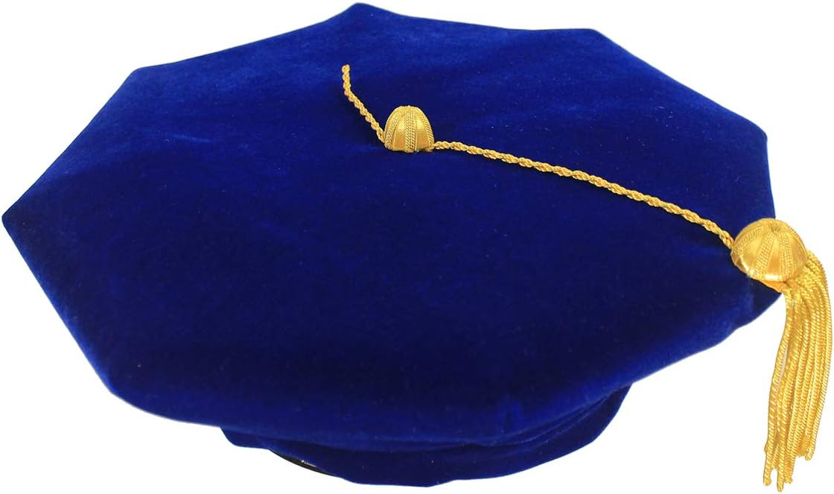
Thank you for Coming!
This Powerpoint presentation is available at http://beau.fiu.edu under the miscellany link

