Slide 1
Crafting Effective CVs for PhD graduates
Richard L Beaulaurier, PhD, MSW

Slide 2
Shout out to my co-authors:
PowerPoint Design Tools
Chat GPT
Spellcheck

Slide 3
Agenda
Understanding what an Academic CV is and how it is different from traditional CVs and resumes.
Understand how a resume fits into an academic job search.
Understand how Resumes are used by employers
Conventional screening
AI screening
Your true audience
Focus on CVs aimed to get your first academic job.

Slide 4
Curriculum Vitae→Lebenslauf→Resume
Historical
Current Professional
Resume
Academic CV
A resume showed the course of your life from the murky past to the present
Could show things considered irrelevant or illegal today
Gender
Age
Class
Bulk was best. Resumes were very long.
Succinct
Shows only
Relevant info about you
Shows only experience relevant to job market.
More like a big calling card than a biography
Designed to be used in screening.
Made to be as long as possible.
Show everything you can legitimately claim
Does not resemble other professional resumes
How many academics does it take to screw in a light bulb?

Slide 5
Resumes and CVs in the USA
Normal Expectations
What not to add
Resumes should be short. Most should be one page in length. Two maximum, but only in exceptional cases.
White paper/background
Easy to read font.
Most important information
Easy to find
Usually at the top
No handwriting
No picture
No High School Information
Limit jobs if they are not relevant
Dates are not usually necessary
No excessive creativity
No robots

Slide 6
Academic CVs in the USA
Normal Expectations
What not to add
CVs should not be short. They should be as long as possible.
They should include EVERYTHING you have done that is relevant
White paper/background
Easy to read font.
Most important information
Easy to find
Usually at the top
No handwriting
No picture
No High School Information
Limit jobs if they are not relevant
Dates are not usually necessary
No excessive creativity
No robots

Slide 7
The first commandment
Thou shalt put nothing in thy CV that will get thee screened out.

Slide 8
Reason for the 1st Commandment…
Thou mayeth have thy CV screened
HR Low person on the totem pole
Most Junior Administrative Assistant
Rando called in because they needed someone to screen CVs
The AI du jour
(notice the robotic smile)

Slide 9
The first stop for your CV is a big pile of CVs
Some low-ranking person may screen CVs from to select 10
Initial screening may not also be done partially or fully by AI
Once cleared, they will be screened by a “search committee”
The search committee will often split up the work and come back with a small number to review
Often they use a quantitative rubric
Only a few will actually be discussed
A few will be selected for further discussion

Slide 10
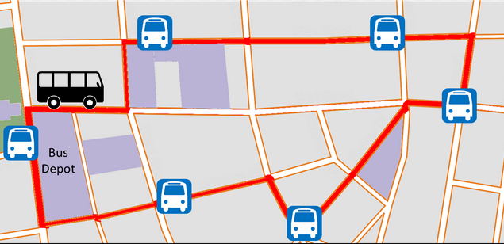
Stops on the Screening Bus
HR, screened for DEI and simple criteria
Search committee*
Member or small group screening, quantitative rubric may be used
Discussion of CV and letters select for Zoom interviews (no more than 10)
Select even smaller numbers for campus visits (initially around 3)
Program Director/Chair*
Academic Dean*
VP for Research (in R1 universities)
Provost
Any one of these stops can screen out your application based on your CV
*If you get a campus visit only these folks will meet you…the rest know only your CV

Slide 11
Getting through the screening
Make your qualifications clear:
Education—First line—First heading
Certifications
Relevant experience
Follow this with things may put you over the top
Special qualification
Memberships
Leadership positions
References
Use key words and language common in SW jobs
Generic
Sector specific
Notes:
The case for independent living.

Slide 12
What does not go in an academic CV?
No objectives
No Goals
No indications of what job you want
No fancy formatting
CVs will be read quickly…fancy formatting gets in the way.
But I heard this joke: How many academics does it take to change a light bulb?

Slide 13
The number is not important. The important thing is to take credit for it in your CV
Almost everything you do as an academic should be in your CV

Slide 14
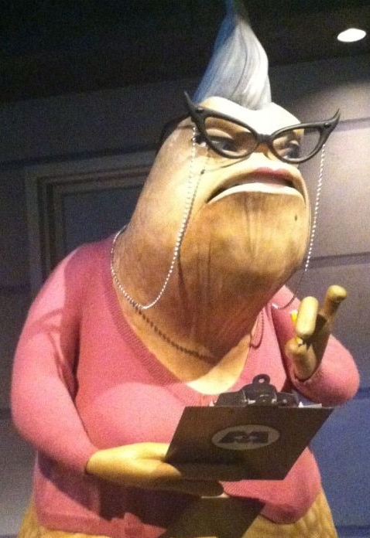
How to get screened out
Make your qualifications hard to find
Misspell or use bad grammar
Use colloquialisms
Fail to include qualifications they have asked for
Fail to include critical details about your qualifications

Slide 15
Start with your name and contact info
* Make sure your PhD is after your name. Don’t make them scroll to your education…they might not.
* If your PhD is “expected” put an asterisk by the by the letters: PhD* and not that it is *expected: August 202X
** If you have an LCSW put it here. This is particularly important post MSW practice experience is not clear
** If you don’t have an LCSW, put MSW. If you don’t have an MSW don’t put anything.
*** If your email is something cute change it to something professional now. Time to be rid of threebutterflies@hotmail.com
*** Don’t use your FIU email. FIU doesn’t let you keep these anymore.
Joan Watson, Ph.D.*, LCSW** 221b Baker Street Yeehaw Junction, FL 34972
Telephone: 305-867-5309 Email: jwatsonphd@gmail.com***

Slide 16
Rich’s Suggested order
Name and contact info
Education
Licenses, Certifications, Certificates.
Academic Positions
Research Affiliations (if you have them)
Professional Associations
Language Proficiency (if you speak any non-English language)
Funded Research (If you have it…if not just “research”)
Minimally Funded or Unfunded Research unless you are just using “research”
University Teaching Experience
Professional Social Work Experience
Other Professional Work Experience
Publications
Presentations
Academic Service
Community Service
Honors and Awards
All sections except the name and contact info should have a heading
OK to invent a new heading if relevant or delete one if not relevant
Notes:
Your degree is your most important qualification upon graduation.

Slide 17
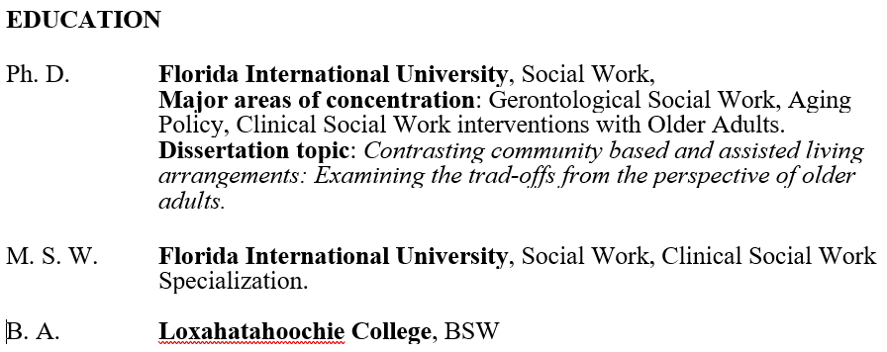
Education
PhD
MSWBSW [or BA]
AA
Dates are optional

Slide 18
Licenses
LCSW
SW licenses from other states (e.g. LMSW
CAP
LMFC
LMHC
Other certificates or licenses
If you don’t have any of these don’t worry
…but if you do…
LCSW if you have this make sure you note it after your name and PhD. An LCSW indicates that you have at least two years of post-MSW practice experience which may be a qualification, and is always desirable.
Other counselling licenses show you can teach clinical HBSE courses
Other certificates and licenses show you have additional qualifications, and that you are keeping your “tools sharp”

Slide 19
Academic Positions
Research Assistant
Teaching Assistant
Graduate Assistant
Scholar
CV Starr Scholar
Fulbright Scholar
Fellow
McKnight Fellow
Presidential Fellow
Veteran’s Fellow
Inclusion Fellow
UGS Dean’s Fellow
Provost’s Tuition Fellowships
Adjunct Assistant Professor
At FIU we often use the generic “Graduate Assistant” but “Teaching Assistant” and “Research Assistant” are more common.
If you have used our GAship to teach list it as TA
If you have used your GAship to do research list it as RA
If you have done both, list them separately
Fellowships and Scholarships can be listed if they were competitive and paid a major part of your studies
If a scholarship was just a little money…or just an honor, put it under honors and awards.

Slide 20
Honors and Awards
Honor societies and other awards
Scholarships and Fellowships that are not academic positions
Phi Alpha or other professional honor society
Dean’s lists
Phi Beta Kappa
Anything that honors your service to a university, college.
Anything that honors your professional service
Anything that honors you for being a good citizen.
Most Fellowships or Scholarships that you got before entering the doctoral program
Dolores Auzenne Fellowships
UGS Writing Fellowships
Scholarships and Fellowships from outside FIU

Slide 21
Research Affiliations & Professional Associations
Organizations you belong to:
Research Affiliations
CSWE
NASW
SSWR
GSA
APHA
IFSW
Any other national or international professional or academic organization.
RCMI
CRUSADA
Center for Children and Families
Latin American and Caribbean Center
Any other research group with a name that you belong to.
Make sure to note if you have been an officer or board member!

Slide 22
Language Proficiency
If you speak a language other than English
List the English and the other language(s)
Note your proficiency by indicating whether are literate as well as conversational in the language
English: read, write and speak
French: read, write and speak
If you don’t speak a non-English language skip this heading ;-)

Slide 23
Research
Break it down if you can
Research comes in several flavors
You have all done something with research even if it is just your dissertation research
If you have had any involvement, even as an RA, even if you were not specifically funded shows that you have been around funded research and that is a plus.
Show any research funding that you have applied for even if you did not get it
If you have something under review that is important
Funded Research
Minimally or Unfunded Research
Research Under Review
Research Not Funded
We all know getting funded is hard
Listing what you have attempted shows persistence
It shows that you know funding requires multiple attempts
It shows you are persistent and serious about getting funded
Notes:
Experience.

Slide 24
University Teaching
If you have taught, you should have a section on teaching.
Even if you will primarily do research, university employers need to know where they can plug you into the curriculum
Identify the parts of the curriculum you can teach in
Human Behavior and the Social Environment
Social Policy
Research (we can all do this…try to have at least one other thing)
Direct/Clinical Practice
Macro Practice
Field of Experience is also important
Aging
Addictions
Clinical Modalities
Chile Welfare
Mental Health
Say what you have done and what you have taught.
Use words like “developed” if you can.
List course titles and numbers*

Slide 25
Professional Social Work Experience
Mostly they are interested in whether you have professional experience that allows you to teach practice courses.
They want to see
Post MSW experience
Post BSSW experience
You do not need a license to teach practice courses
You can teach MSW or BSSW practice courses if you have two years post MSW practice experience
You can teach BSSW practice courses if you have two years post BSSW practice experience
Other SW or SW-adjacent experience is of some interest, but is not a qualification
CSWE will sometimes grant course-by-course exceptions to this rule in the specialization year of the master for professionals with relevant experience

Slide 26
Publications & Presentations
Have as many sub-sections as you have things to put in them!
You should include “submitted,” “under review,” and “revise and resubmit” in addition to published material
Sections could include
Journal articles
Journal Special Issues (where you are an editor)
Books
Book chapters
Peer reviewed technical reports
Reviews
Other Academic publications (e.g. non-peer review reports that have been published.
Presentations
I typically do not have separate sections for talks, posters or panels…but you can if you wan to.

Slide 27
Academic and Community Service
Any service that you have performed for FIU, or another university should be listed here.
Any university activity that is not research or classroom teaching
Any community service that you do should be listed here.
Anything you did in the service of clients, agencies or policy advocacy

Slide 28
So many categories!
Don’t feel like you need to use all the categories listed in this presentation.
If there is nothing to put in a category…don’t use it!
BUT DO keep the list of categories.
They will become more useful as you develop more things to put in them
They will also give you some ideas of things to be working on as you move through the program

Slide 29
Calling Card
You may be as likely to get a job with your CV as a calling card than applying electronically.
Develop your CV NOW
Always have it handy to give to people who might have a job for you…or might know someone who does.
Most positions will go through the committee process anyway, but it is good to have an advocate
Develop contacts and be prepared to hand them a CV.

Slide 30
But what about AI?
AI is being used more frequently by employers as part of the screening process
AI is also being used by job-seekers
The title of this presentation was generated by AI
AI suggested content for this presentation
AI provided some helpful information…
…but not that much…

Slide 31
Robot Overlords? Not quite…
I do not recommend using AI to develop your CV
AI spells well and has good grammar, but…
A CV is like a tailored suit…it only fits one person
AI has a lot of general knowledge but lacks expertise, and is often wrong.

Slide 32
Screening with AI
Increasingly employer are using Applicant Tracking Systems (ATS)
ATS can filter CVs based on keywords, and qualifications, formatting analysis, and natural language processing (NLP)
HR may believe ATS is less biased. (may not be true…but the ATS system are marketed as if they are.)
HR may believe that ATS is more efficient (i.e. cheaper…and they are probably right)
AI makes it possible to process enormous quantities of CVs and come down to a few.
Converts unstructured data to structured data.
Makes side by side comparison easier for human reviewers.
Can do contextual analysis for relevance of key words.
Filter based on pre-defined criteria.
Not terribly prevalent now…but they may become more prevalent.

Slide 33
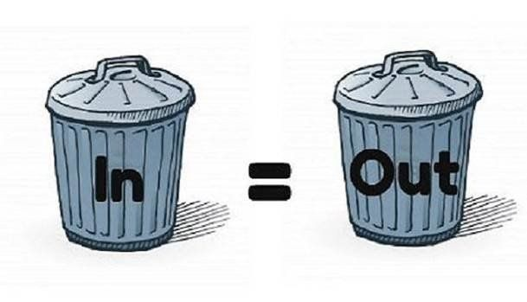
What could go wrong screening with AI? GIGO part 1
Pre-defined criteria may be biased.
Only eliminates known human bias, but does may include systematic or implicit bias
HR may believe ATS is less biased. (may not be true)
HR may believe that ATS is more efficient (i.e. cheaper)
AI will rank if told to, whether it makes sense to or not
Will filter based on criteria that it’s given
Biases toward structure
Can be superficial

Slide 34
There will be more ATS GIGO part 2
AI can be superficial
It can bias toward overgeneralization
Particularly true when employers don’t know exactly what they want
If criteria given to the AI are biased, the filtering will be biased.
…BUT…
It is cheaper (at least in the short run) to buy an ATS than it is to hire screeners
Employers are getting more and more CVs for positions they open. Need a quick screening tool.
Although ATS may be filled with systematic and implicit bias, it is being marketed as “objective” and not subject to “human bias”

Slide 35
What can you do about AI Screening?
Rich Says…
Do your own keyword optimization by looking at job descriptions.
Use the AI for suggestions about how to phrase things.
Be MORE specific than the AI about your activities and experiences.
Give the CV to a human to read…preferably a mentor.
Have a good LinkedIn Page

Slide 36
Thank you !

